Slide 1
Practice Management

Slide 2
Essential Standard 2.00
Apply proper communication skills in a clinical setting

Slide 3
Objective 2.01
Implement the proper techniques to schedule appointments and manage clients

Slide 4
Essential Questions:
How do members of the veterinary team schedule appointments?
What are the types of appointment schedules?
What are the types of appointments in a veterinary facility?
How should the assistant keep the appointment book organized?
What are policies or procedures?

Slide 5
Essential Question
How do members of the veterinary team schedule appointments?

Slide 6
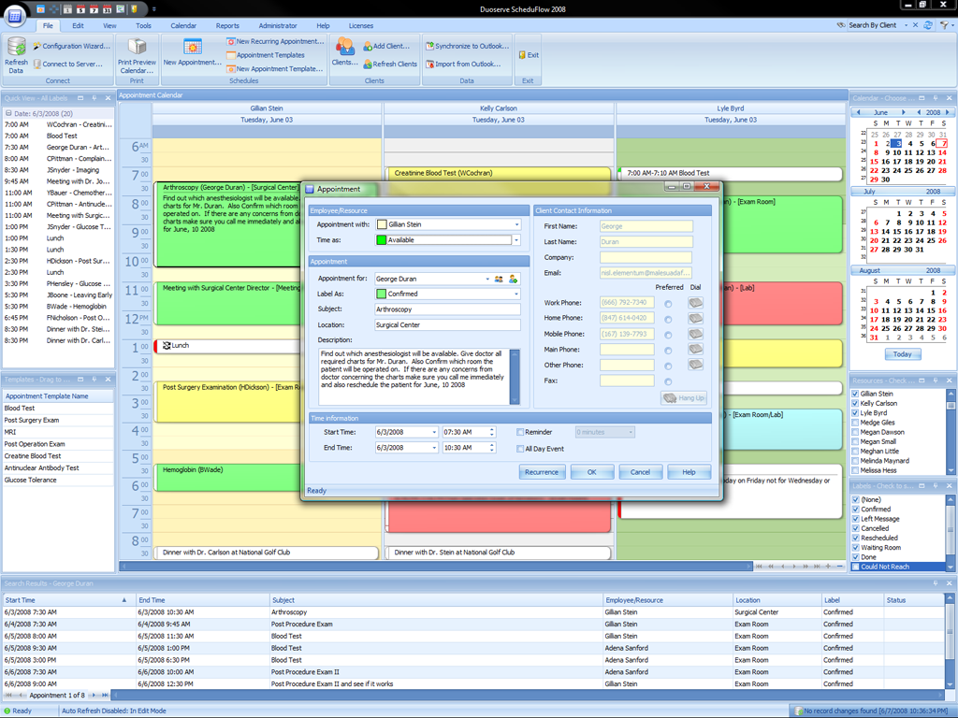
Veterinary Appointment Book
Typically done through computerized systems although some facilities still use paper systems

Slide 7
Types of Appointment Schedules
Wave
Maintained by veterinarian that sees a total number of patients within a set time
Veterinarian will determine how many patients in an hour
Flow
Based on each patient being seen at a specific time with the most common interval being 15 minutes
Schedule is easy for the veterinarian to get behind
Fixed office hours
Clients are seen as they arrive
There is little control over the flow of patients

Slide 8
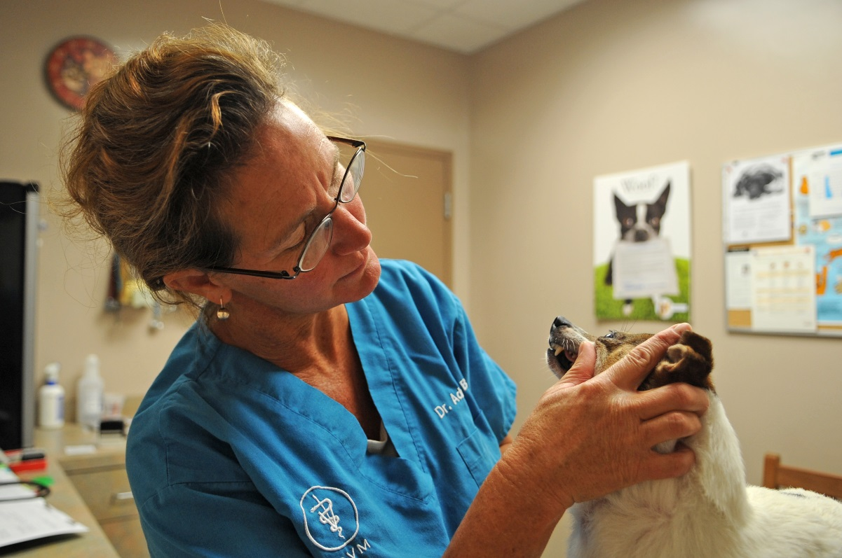
Types of Appointments
Routine Appointments
Seen during the appointment schedule with each routine spaced out according to how long it is expected to take
Yearly physical examinations
Vaccinations
Sick patient exams

Slide 9
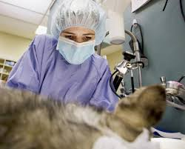
Types of Appointments
Surgical Appointments
Kept in a separate appointment book and schedule
Done at specific times of the day
May have specific days for specific surgeries
Surgery schedules may have a specific drop off time
Schedule should include the following:
owner name
phone number
patient name
breed or species
surgical procedure

Slide 10
Types of Appointments
Surgical Appointments
Pre-surgical instructions are given to the client and should include:
Not feeding 12 hours prior to surgery
Not giving water 8 hours prior to surgery
Bring in pet at a specific time
Signing surgical release form
Signing pre-surgical blood work consent form
Signing estimates for services
Alerting the staff and bringing in prescribed medications

Slide 11
Emergency and Walk-In Appointments
Emergency is an appointment that must be seen immediately and is a life or death situation
Common emergencies include: hit by car, severe wounds, bloat, and others
Walk-Ins are clients that show up without an appointment
To serve emergencies and walk-ins- allow several slots during the day to space out so not to interfere with already scheduled appointments

Slide 12
Drop Off Appointments
Allows for flexibility for both the owner and staff
It is important that the owner sign consent forms with contact numbers for the health care team if any questions arise

Slide 13
House calls
Usually at the client’s home or farm
Most hospitals will take phone calls and return messages after reviewing schedules
All files for clients should be assembled prior to the appointment
Extra forms are included in the case that there is an unreported problem

Slide 14
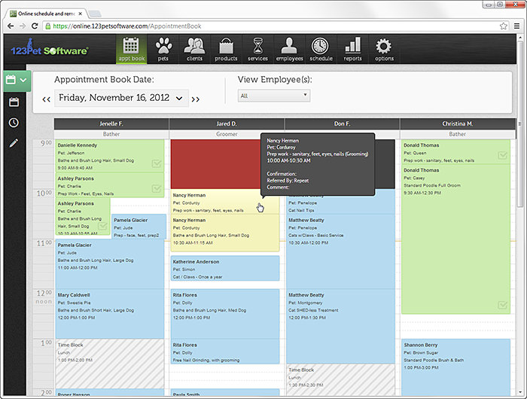
Organization of the Appointment Book
Most appointment books are available with 15 minute time slots
The appointment book should have ample room to write in all information

Slide 15
Scheduling Appointments
All information should be written in pencil
Changes can be made if an appointment cancels or needs to be rescheduled
If filing system method is alphabetical then appointment should be written last name first
If filing system is numeric then record the client number
Hospital will have recommendations for common veterinary procedures and the amount of time that the appointments should take.

Slide 16
Working with the client
When an appointment is scheduled, read back the date and time of the appointment to make sure all information is accurate
When at all possible give appointment cards to remind clients of appointment dates
Be sure new clients have clear directions to the facility

Slide 17
Policies and Procedures
Provided to each staff
Policy manual
Provides information regarding what the staff expectations are
Procedures manual
Provides rules regarding the workings of the veterinary facility

