Slide 1
Objective 2.02
Execute effective communication through written, verbal, and technological formats.

Slide 2
Essential Questions
What are the essential components of communication?
What is the difference between verbal, non-verbal, and written communication?
What is the different communication skills needed in a veterinary facility?
How do veterinary assistants interact with people?
How can you handle grief while effectively communicating with clients?

Slide 3
The Communication Process
Five essential components
Sender- person trying to relay an idea
Message- the idea
Receiver- person intended to understand the message
Channel- route of communication (verbal, non-verbal, and written)
Feedback- receiver returns message

Slide 4
The Communication Process
Verbal communication
Spoken words between two or more people
Most common
Important to be able to speak well to other people

Slide 5
The Communication Process
Non-verbal communication
Interaction between people without the use of spoken words
Body language- mannerisms and gestures that tells how a person feels
Positive body language will assist in dealing with upset clients

Slide 6
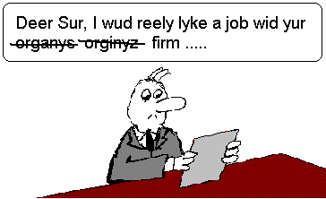
The Communication Process
Written communication
Used for progress records, writing letters, memos, emailing or texting someone
Must be clear, accurate, and understandable
Keep a notepad and pencil next to the telephone to record accurate messages

Slide 7
The Communication Process
Technological communication
Many animal hospitals today use alert systems to send out reminders via email, text messages, or utilize social media
written communication through non-traditional means
treat this form of communication as written and each message should be cognizant of limitations to avoid complications

Slide 8
Appropriate communication skills
Courtesy
putting someone else’s needs and concerns before your own
all people should be treated with respect and professionalism
Kindness
exemplifies being helpful, understanding, and working in a friendly manner
treat others as you would like to be treated

Slide 9
Appropriate communication skills
Patience
trait that demonstrates calm demeanor in all situations without any negative complaints
Tactfulness
doing and saying the appropriate things at the correct time

Slide 10
Appropriate communication skills
Sympathy
sharing feelings with each other in a time of sadness
Empathy
being able to understand another’s feelings at a particular time

Slide 11
Interacting with people
Speaking
Speech communication requires practice and experience
Conversations from people may have no focus on the task at hand and will have to be clarified
Remember that each person is different so treat each person as an individual
Listening
Essential in veterinary field
Train to focus on what is being said
Hear what is being said and think about the words to clearly understand the main point
Observation
Used to pay attention to a person’s body language and speech

Slide 12
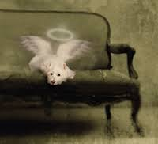
Grief and Communication Terminology
Grief
an emotion that people feel after they have lost a pet or loved one. The close emotion is known as the human animal bond
Euthanasia
process of humanely ending an animal’s life

Slide 13
Grief and Communication Terminology
Humane
used to describe what is considered acceptable by people in regards to an animal’s mental, physical, and emotional well-being
Shock emotion of sudden death of a pet
Denial
person may not accept the pet’s death

Slide 14
Grief and Communication Terminology
Bargaining
allows the person an attempt to resolve the pet’s problem by any means possible
Acceptance
owner understands and accepts that the pet has passed away
Anger
natural emotion in the event of the trauma

Slide 15
Grief and Communication Terminology
Sorrow
emotion that leads to sadness over the loss of the pet
Depression
state of sadness where a person becomes so sad they can’t handle the normal functions of daily life
Guilt
stage when a person feels he or she should be able to do something to save the pet

