Slide 1
Veterinary Assisting Unit B
Pharmacy and Laboratory Procedures

Slide 2
Essential Standard 3.00
Analyze the requirements for ethically and legally handling pharmaceuticals.

Slide 3
Objective 3.01
Analyze the legal issues involving drugs in the workplace.

Slide 4
Essential Questions
What are the types of drugs that may be handled in a veterinary pharmacy?
What are the legal requirements of prescribing medications?
What are the legal requirements of labeling prescriptions?
What are the guidelines for storing medications?

Slide 5
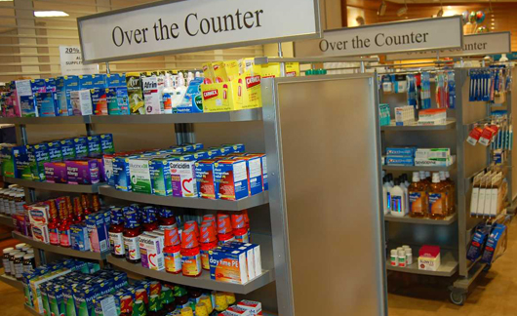
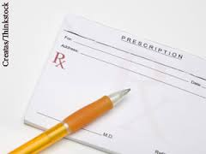
Types of Medications
Over the Counter
can be purchased by anyone at any time
Prescription
can only be ordered by licensed veterinarian

Slide 6
Types of Medications
Controlled substances
Prescription drugs that have a high abuse potential
Regulated by the DEA
Can only be prescribed by licensed veterinarian
Must be legally stored behind two locks
Outer locked area must be permanently fixed in place
Limited access
Controlled substance log must be kept

Slide 7
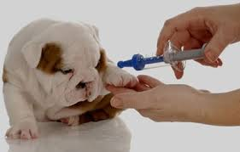
Types of Medications
Vaccinations
Given to prevent diseases
Most often given by intramuscular, subcutaneous, or intranasal routes
Frequency of vaccination depends on the specific disease being vaccinated against
Initial vaccines given to young animals must usually be boostered within 3-4 weeks of the very first vaccine

Slide 8
Veterinarian/Client/Patient Relationship
In NC, a veterinarian must have performed an exam on the patient within the past 12 months to legally write a prescription

Slide 9
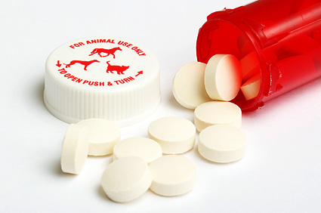
Reading a Prescription
Prescription written by a veterinarian will include the following information.
Medication name
Medication strength
Method of administration
Amount to be administered
Frequency of administration
Length of use
Amount to be dispensed
Special instructions
Number of refills
Veterinarian name and address
Owner’s name and address
Date
Veterinarian’s signature

Slide 10
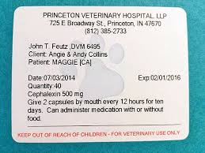
Labeling a Prescription
NC law requires the following information be included on all prescription labels:
Veterinary facility
Address
Phone number
Name of prescribing veterinarian
Client name
Client address, if controlled substance

Slide 11
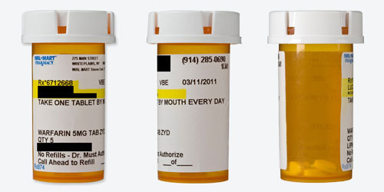
Labeling a Prescription
Patient name or ID number
Medication name
Medication strength
Date dispensed
Amount per treatment or use
Route of use
Frequency of treatments
Length or duration of use
Quantity dispensed
Expiration date
Number of refills
Special instructions

Slide 12
Medication Storage
Oldest dates first
Remove outdated items
Store according to storage recommendations on insert
Room temperature or refrigerated
Away from direct sunlight
Dry
Alphabetical order

