Slide 1
Objective 6.02
Differentiate microbes and parasites to identify disease processes.

Slide 2
Essential Questions
What are the various types of microorganisms that contribute to disease processes?
What are some of the common animal external parasites?
What are some of the common animal internal parasites?
What is the importance of zoonosis in humans?

Slide 3
Disease
Abnormal change in the structure or function within the body
5 primary disease causing micro-organisms- Viral, bacterial, fungal, protozoan, rickettsial
Microbiology- study of microorganisms
Many are beneficial
Pathogens- disease causing microorganisms

Slide 4
Disease
Contagious diseases
can be spread to other animals or humans
Direct contact- diseases that are spread by contact with an affected animal or body fluid.
Indirect contact- spread by ways other than touching.
Ex: airborne or through equipment and bedding.
Non-contagious diseases
do not spread between animals

Slide 5
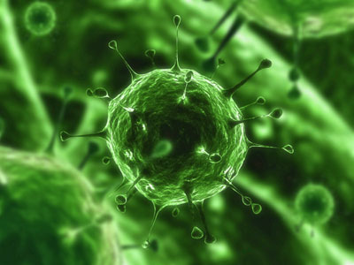
Viruses
Particles that are contagious and spread through the environment
can only live inside a host cell
cannot get nourishment or survive outside a cell
antibiotics are not effective treatments
supportive care is the treatment of choice
fluid replacement
pain management
anti-pyretics (fever reducers)
medications for vomiting and diarrhea
Well known viruses
influenza, West Nile virus, HIV

Slide 6
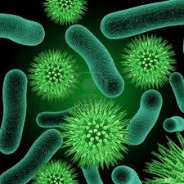
Bacteria
Single celled organisms that can cause disease
Beneficial flora- bacteria that normally live in or on an animal that help maintain the health of the animal.
Ex: intestinal bacteria that help with digestion
Pathogenic bacteria
bacteria that cause disease
Opportunistic bacteria
usually only cause disease when an ‘opportunity’ presents itself (eg: trauma, previous viral infection)
Symptoms- depend on location of invasion.
Ex: diarrhea, pneumonia, sinusitis, etc

Slide 7
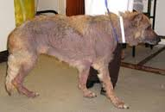
Fungal disease
Caused by a pathogenic fungus or spore
Generally require warm moist environments to grow
Usually occurs in immunologically impaired animals
Can be very difficult and expensive to treat
Use antifungal medications

Slide 8
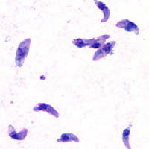
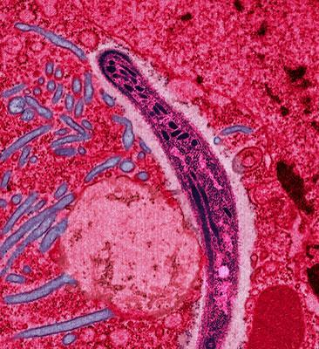
Protozoal diseases
Single celled parasites that may survive in or out of the body
Most feed off of dead or decaying matter and cause disease in animals that ingest them.

Slide 9
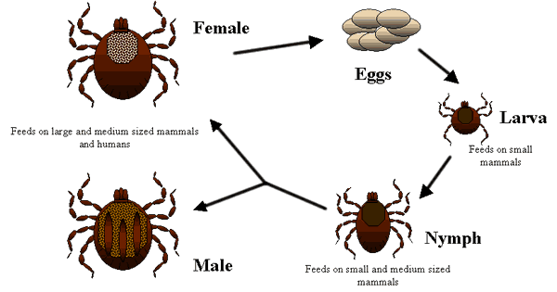
Rickettsial diseases
Spread by biting insects like ticks or fleas.
Must be in a host cell to reproduce.

Slide 10
Parasitology
The study of organisms that live on or in other organisms to survive
Parasites – may invade the internal or external parts of animals
Most have one location that they live in, and they feed off the host, or animal that is infected
Go through a life cycle: born as larvae and grow until capable of reproduction
Can be controlled and prevented through proper sanitation and disinfection methods
Enters the body many different ways
Parasites can invade digestive tract, skin, or muscles of an animal.

Slide 11
Internal Parasites
Occur in small and large animals
Include ringworms, whipworms, hookworms, heartworms, coccidian, tapeworms, and strongyles
Many internal parasites invade the intestinal system causing vomiting and diarrhea
Intestinal Parasites are diagnosed through fecal floatation

Slide 12
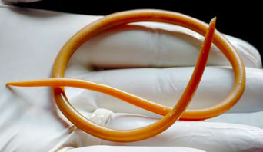
Roundworms
Ascarids – most common intestinal parasite in small and large animals
Often occur in young animals
Live in small intestine
Can lay up to 200,000 eggs a day
small animal symptoms- vomiting, diarrhea, bloated stomach, visible roundworms in feces
large animal symptoms- abdominal pain (common cause of obstruction colic in foals), coughing and diarrhea, visible roundworms in feces
diagnosed by finding eggs in feces- eggs are circular with dark circular centers

Slide 13
Toxascaris leonina
Simplest life cycle
Eggs hatch after it is ingested
Eggs are passed in the feces
After 3-6 days, they are infective in the environment
Animals become infected if they eat something contaminated with the infected feces

Slide 14
Toxocara canis
Complicated Lifecycle
Hardy and resistant
Animal can become infected by ingestion of eggs, transport host, or by larvae entering the animal while in the uterus
Migrate through circulatory system
They can encyst (become walled off or inactive) if enter body tissues

Slide 15
Toxcara cati
Similar to T. canis
Infective eggs are swallowed; larvae hatch; and penetrate the stomach wall
Larvae migrate to liver, other tissues, and lungs

Slide 16
Parascaris equorum
In large animals
Are swallowed in contaminated hay or water
Young worms burrow through the intestinal wall
Mature in intestine and lay eggs that are passed in the feces
In small animals
Infection will show signs of vomiting, diarrhea, and bloated stomach; is visible in feces

Slide 17
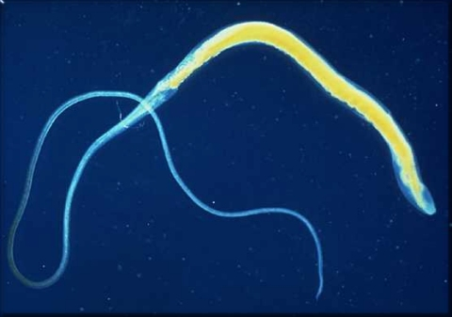
Whipworms - Trichuris vulpis
Infect animals through ingesting contaminated food or water
Common intestinal parasite
Whip-like shape
Live in large intestine of infected animals
Symptoms include diarrhea, weight loss, possible blood in the feces, and anemia
Adult whipworms are not visible in the feces
Diagnosed through finding football shaped eggs in the feces

Slide 18
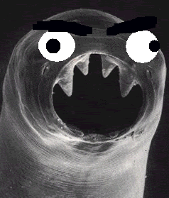
Hookworms - Ancylostoma caninum
Live in the small intestine of host animal; feed off blood
Common intestinal parasite of dogs and occasionally cats
Teeth-like structures or cutting plates – attach to wall of intestine and feed on animals blood
lay eggs that pass out in the feces
larvae is released after the eggs are hatched and travel through raindrops or dew on leaves
enters host by being ingested or by burrowing through the hosts skin
Symptoms include vomiting, diarrhea, anemia, weakness, black darkened feces, dull coat appearance, occasional coughing
Diagnosed by finding clear oval eggs in the feces
Zoonotic disease: cause cutaneous larval migrans in humans where larvae burrow through humans skin, most common in young children

Slide 19
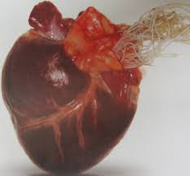
Heartworms Dirofilaria immitis
Affects the heart and circulatory system of infected animals
Spread by the mosquito
Most concern in dogs, cats, and ferrets
Microfilaria – the very tiny larvae that adult heartworms lay in the heart
enter mosquito and then enter the animal’s skin
larvae grow and migrate to the heart
Symptoms in dogs-may have no symptoms with light infections, but with increasing worm loads will display exercise intolerance, difficulty breathing, coughing, decreased appetite, weight loss and lethargy
Symptoms in cats- typically show no signs but may die suddenly or may show signs similar to dogs
Simple snap blood tests are available for diagnosing heartworms
Treatment is a concern as dyeing adults may block blood flow from the heart and lead to sudden death
Prevention with monthly treatments is the better way to manage heartworms

Slide 20
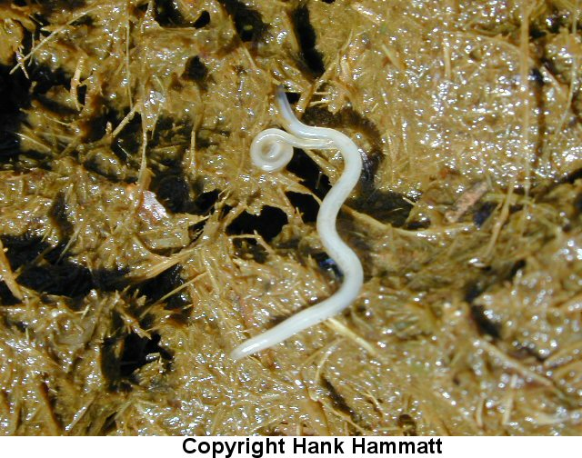
Strongyles
Common parasite of large animals
Bloodworms or redworms
Eggs in manure hatch into larvae
Larvae mature in the intestinal tract and can cause extensive damage to the lining of blood vessels
Signs of large strongyles: weight loss, anemia, abdominal pain, and sudden death
Small strongyles do not migrate through tissues as large ones do. Encysted larvae require special anthelmintic treatments to kill.
Signs: diarrhea, weight loss, poor growth, poor coat quality, and abdominal pain

Slide 21
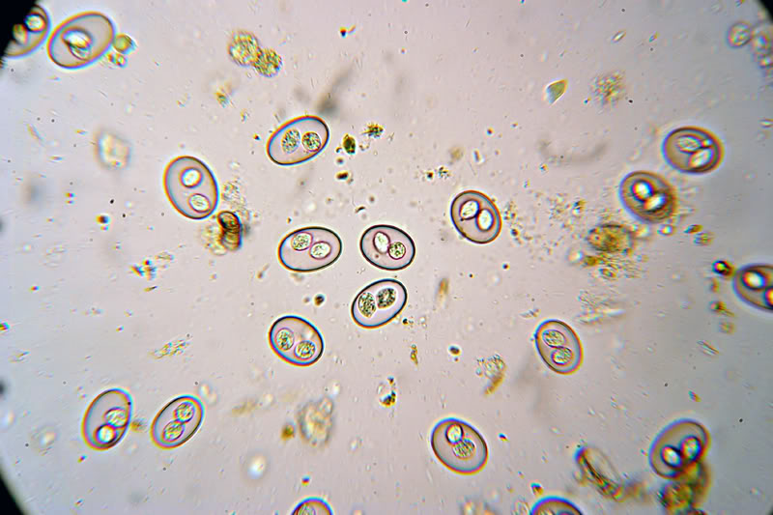
Coccidia
Common protozoan internal parasite
Coccidiosis is the disease name
Iospora cania – commonly infects animals
Oocysts will be shed, or the single-celled eggs in the feces
Eggs live in the intestinal tract
May be no illness signs, others include diarrhea, blood and mucous present

Slide 22
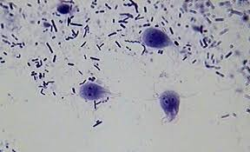
Giardia
Giardia lamblia is a protozoan or single-celled organism that lives in the intestinal tract of animals
Common occurrence in water sources that are outside or contaminated
Signs: diarrhea, vomiting, weight loss, and poor overall appearance.

Slide 23
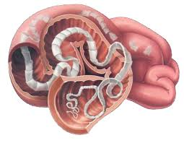
Tapeworms
Flat worms that are segmented or have individual parts that grow and shed as the parasite ages
Live within small and large intestine
Proglottids – segments shed in feces that may often be seen near the anus of dogs or cats
Is developed commonly by the ingestion of a flea
2 common species:
Dipylidium caninum – can be up to 20 inches long; lives in small intestine
Taenia species
Signs: poor hair coat, abdominal discomfort, and visible segments in the feces

Slide 24
External Parasites
Several invade all types of small and large animals; they live in hair coat, on skin, or within the ear canals

Slide 25
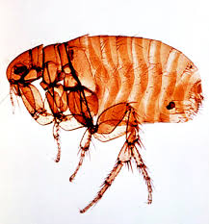
Fleas
Adults: reddish brown, wingless, and hard shells
Jump
Feed on blood
Lay 15-20 eggs a day
Eggs hatch in fall
Cause itching and scratching
Treatments available include spot ons, environmental control is key
Flea allergy dermatitis – severe skin irritation and itching in some animals, the flea saliva causes an allergic reaction when the animal is bitten. Signs: itching, scratching, biting at skin, hair loss, scabs or bumps.
Anemia – loss of blood, can be caused by fleas. Bartonella – bacteria spread by fleas; common in cats. Hemobartonella or Felina Infectious Anemia – caused by flea bite with bacteria, infects animal’s red blood cells and immune system; common in cats.
Plague – less common condition caused by flea bites

Slide 26
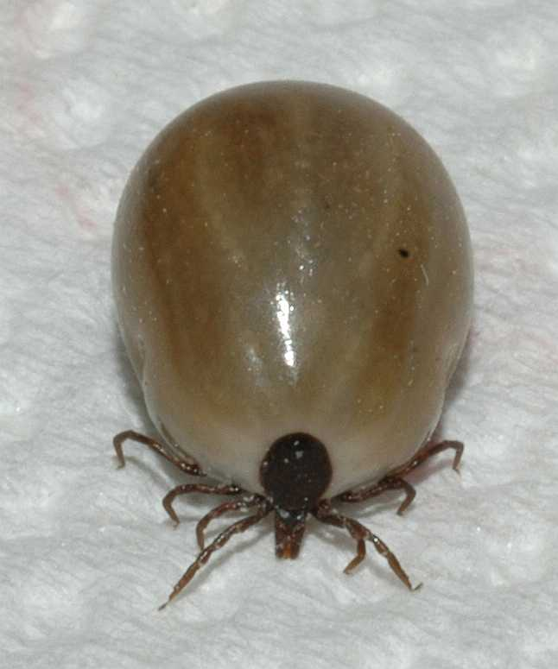
Ticks
Arthropods that seek heat and movement
Common species: American Dog Tick, the Deer Tick, the Brown Dog Tick, the Lone Star Tick, and the lxodes species
American Dog Tick – transmits disease known as Rocky Mountain Spotted Fever. Signs: fever, joint pain, depression, and anorexia.
Deer Tick – transmits a common disease called Lyme disease. It causes joint pain, lameness, fever, depression, anorexia, lethargy, and swelling of joints.
Babesia – another disease spread by ticks. Signs: anemia, jaundice, fever, and vomiting.

Slide 27
Lice
Wingless; stick to hair coat
Life cycle 3-5 weeks
Adults are visible
Itching and hair loss
Treatment available
Nits – lice eggs

Slide 28
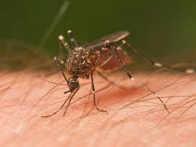
Mosquitoes
Very small flying insects; survive on blood
Capable of spreading diseases from animal to animal
West Nile Virus – mosquito-borne disease that causes inflammation or swelling of the brain and spinal cord
Also carry heartworm microfilaria

Slide 29
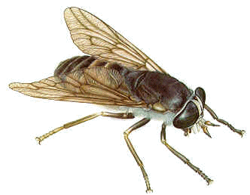
Biting Flies
Can cause lots of irritation
Equine Infectious Anemia – viral disease; no vaccine and no cure for it. Coggins Test – screens for the EIA virus
Prevention: use of fly sprays and manure, waste control and waste removal are helpful

Slide 30
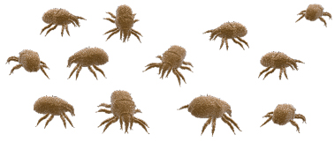
Mites
Many forms and invade several areas
Ear Mites – common, produces a dry black ear discharge; live about 2 months
Mange Mites – live on skin and hair coat
Two types: sarcoptic mange and demodectic mange
Sarcoptic Mange – caused by infection with the Sarcoptes scabei mite
Causes condition known as scabies in humans
Highly contagious by direct contact
Demodectic Mange – another mite that invades the skin and all dogs raised normally by their mothers possess this mite
most dogs recover without any problems
not contagious

Slide 31
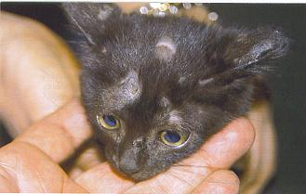
Ringworm - Dermatophytosis
Fungus on skin
Hair loss, with itching in large patches
Circular skin lesions
Contagious to humans and other animals

Slide 32
Deworming Program
Small and large animals should be on it
Large animals wormed every 6-8 weeks
Small animals wormed yearly. Most internal parasites are also killed by heartworm prevention.
Must be chosen according to the type of parasite that is present

Slide 33
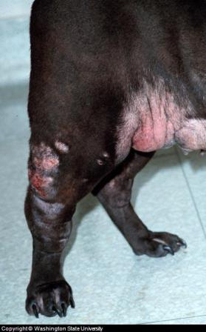
Neoplasia
Commonly called cancer
Some common signs: abnormal swellings that persist or continue to grow, sores that do not heal, weight loss, loss of appetite, offensive odor, depression
Many different types
Treatment includes chemotherapy, surgical removal, radiation, cryosurgery, medications, or a combination of treatments

Slide 34
Zoonosis
Diseases that are transmitted from animals to humans. Many do not show signs of illness. The large majority of zoonosis are not clinically significant.

Slide 35
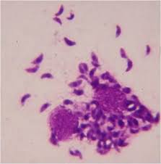
Toxoplasmosis
Toxoplasma gondi – simple-celled organism that can occur in any mammal but is shed through the feces of cats
Cats that have this shed oocysts in their feces can survive several years
Cats become infected through eating rodents or birds
Recommended that pregnant women do not handle litter boxes as it can cause abortions

Slide 36
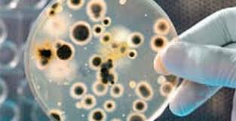
Brucellosis
Reproductive disease that can affect all mammals; concern in dogs and cattle
Contagious; spreads through vaginal discharge
Causes abortions, fertility problems
No treatment available

Slide 37
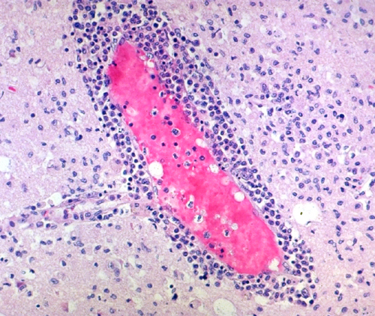
Encephalitis
“Sleeping sickness”
Group of viral diseases that affects horses and people
Eastern Equine Encephalitis, Western Equine Encephalitis, and Venezuelan Equine Encephalitis
Spread by mosquitoes
No treatment available but have vaccine to prevent

Slide 38
Maintaining Good Animal Health
Vaccination programs
Knowing common diseases
Preconditioning prepared young animals for possible stress factors
Clean and sanitary environment
Maintaining Good Animal Health
Proper nutritional program
Proper space
Yearly physical exam and health program

Slide 39
Treating Disease
Biologicals – drugs used to treat disease
Antibiotics – group of medications used to kill bacterial and some rickettsial and protozoal organisms
Anthelmintics – group of medications used to treat internal parasites
Injectable, oral, or topical

