Slide 1
Handling Pharmaceuticals
3.02

Slide 2
Objective 3.02
Apply knowledge of pharmacy laws to properly fill prescriptions.

Slide 3
Essential Questions:
What are the legal requirements of dispensing prescription medications?
What are the routes of administration possible for medications?
What should be included in client education about prescription medications?

Slide 4
Dispensing Medications
Must be dispensed in childproof container
Client can request a non-child proof container due to physical impairment
Bottles or containers may be colored to reduce light exposure
Triple check all drug names
Verify expiration dates

Slide 5
Dispensing Medications
Remember rights of medication administration
Right patient
Right drug
Right strength
Right quantity
Right frequency

Slide 6
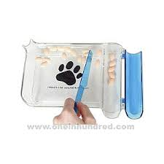
Amount to Dispense
May need to be calculated
All matches should be double checked
Medications may be counted, using a pill-counting tray

Slide 7
Educating Client on Medication Use
Carefully go over instructions to client
Teach how to administer
Explain
Why medication is being administered
How medication is to be administered
How much is to be administered
When the medication is to be administered

Slide 8
Administering Oral Medications
Tablets, capsules, or liquids
Placement at the back of the mouth for swallowing
Pet piller
Used to place medication in back of throat
Balling gun
Dispensing device used for large animals

Slide 9
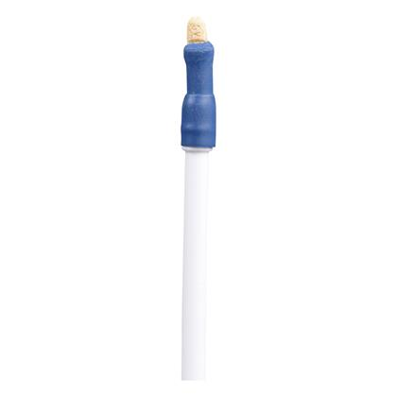
Pet piller

Slide 10
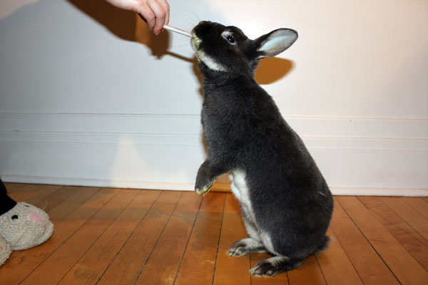
Administering Aural Medications
Instillation in the ear canal
Used to treat ear infection or mites
Breakdown of wax buildup
Usually liquid

Slide 11
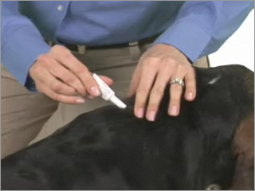
Administering Topical Medications
Applied to the skin
Antiseptics, flea and tick preventions, and wound treatments

Slide 12
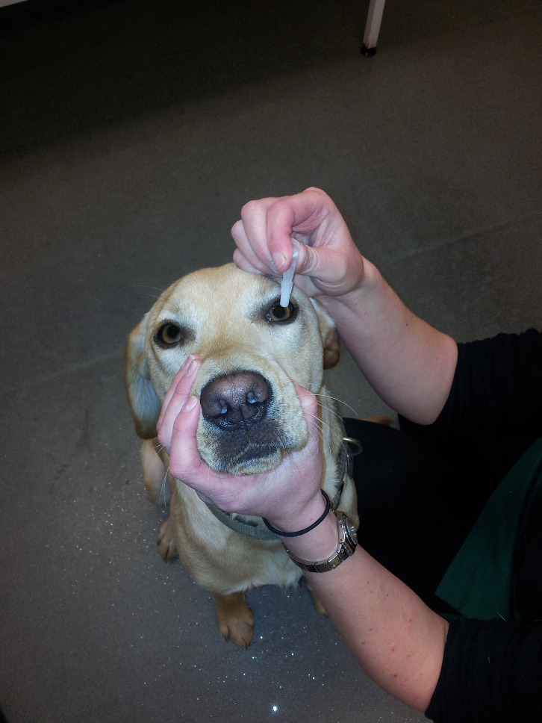
Administering Ophthalmic Medications
Applied to the eyes
To treat eye conditions
Used to protect eyes during bathing
Must be kept sterile
Liquid or ointment

Slide 13
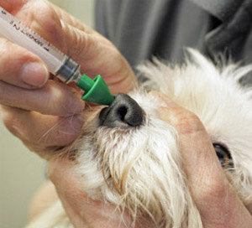
Administering Injections
Veterinary practice acts in some states may allow the veterinary assistant to perform the following injections
Subcutaneous
Administered under the skin
Intranasal
Administered into the nose
Intramuscular
Administered into muscle

Slide 14
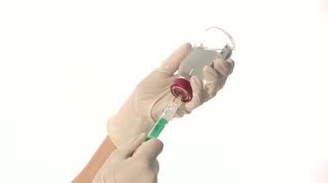
Filling a Syringe
Things to consider before completing task
Syringe size
Volume should be slightly larger than required dose
Allow for aspiration (removing air bubbles)

Slide 15
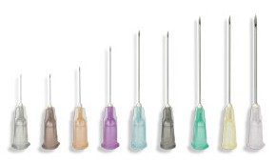
Filling a Syringe
Things to consider before completing task
Needle size (gauge)
Determined by patient size, thickness of liquid, and injection rate
The greater the diameter of the needle, the lower the gauge
The thicker the drug, the lower the needle gauge
The more rapid the administration, the lower the needle gauge

Slide 16
Filling a Syringe
Labeling a syringe
Drug or vaccine name/type
Amount or dose prepared
Date
Patient name
Initial of person preparing the syringe

Slide 17
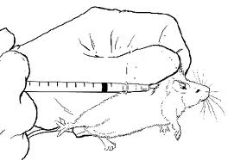
Injections
Subcutaneous Injections
Frequently used for vaccines and antibiotics
Administered at base of neck between the shoulder blades
Avoid passing needle outside skin

Slide 18
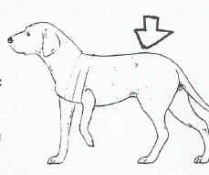
Injections
Intramuscular Injection
Common injection sites
Small animals
Quadriceps
Hamstring
Epaxial
Large animals
Brisket/Chest
Neck
Hamstring

Slide 19
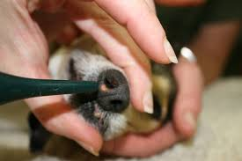
Injections
Intranasal Injections
Placing drops of liquid in nasal cavity
Respiratory medications and vaccines may be given this way
Elevate the head and neck so the drops don’t leak back out

