Slide 1
Proper Laboratory Procedures

Slide 2
Essential Standard 4.00
Apply proper skills in laboratory procedures.

Slide 3
Objective 4.01
Implement proper techniques for collection and analysis of laboratory samples.

Slide 4
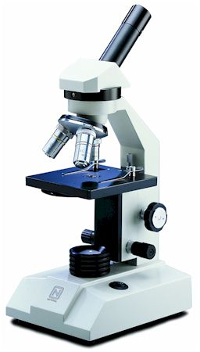
Veterinary Laboratory Equipment
Microscope
Useful for basic testing procedures and can help identify and diagnose problems
Veterinary assistants are responsible for the care and use
Cover the microscope when it is not in use
Be trained on the use so they understand all working parts of it
Each microscope will have several objectives to view under different magnifications
A slide is placed on the stage of a microscope
Slides are viewed through the eye piece
The focus knobs are turned to properly view the sample
All lenses should be cleaned after each use following the manufacturer’s instructions
All slides and cover slips should be clean and have no cracks

Slide 5
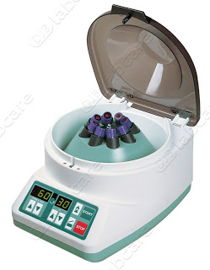
Veterinary Laboratory Equipment
Centrifuge
Used to spin lab samples at a high rate of speed and force
Most facilities have two types:
Microhematocrit tube- thin, small glass tubes that hold blood
Standard- used to spin larger volumes of liquid
When a sample is placed in the rotor, the lid is closed and secured, then placed on the proper setting and time
No one should stand directly over the centrifuge

Slide 6
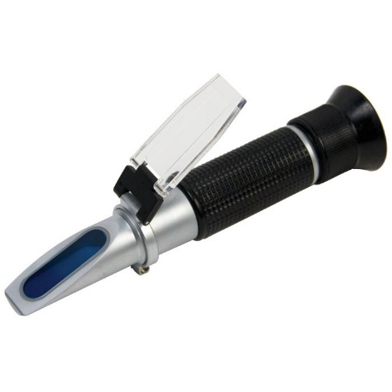
Veterinary Laboratory Equipment
Refractometer
Tool used to measure the weight of a liquid and determine a liquid’s pH level
A liquid sample is place on the prism
Then held to a light source and viewed to determine specific gravity
Has to be calibrated periodically with distilled water

Slide 7
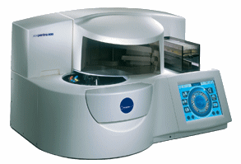
Veterinary Laboratory Equipment
Blood Chemistry Analyzers
machines that run blood samples including complete blood counts (CBCs) using whole blood, serum, or plasma

Slide 8
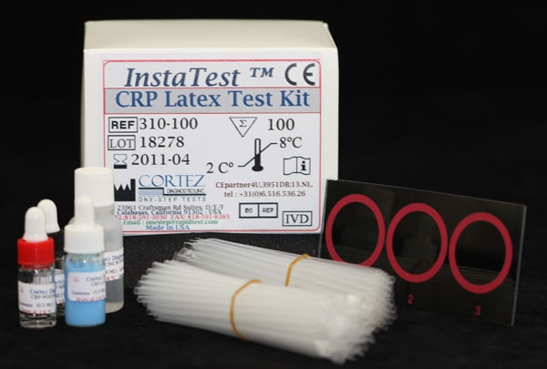
Veterinary Laboratory Equipment
Serological Test Kits
chemical kits to determine viruses and diseases with reagents that typically are kept in the refrigerator
veterinary assistants need to be familiar with kits used by the facility

Slide 9
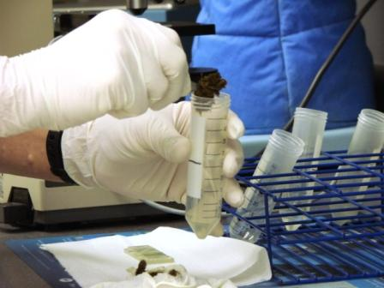
Fecal Sample
Used to diagnose internal parasites and the presence of blood in a stool sample.
gross examination (visual observation) including:
color, consistency, odor, presence and color of blood, presence of observable parasites, presence of mucous, and presence of foreign material or debris
perform a fecal smear by placing a small amount of sample onto a microscope slide
If the sample is dry it may require 1-2 drops of saline
veterinarian or veterinary technician reads the sample under the microscope
fecal flotation is used to determine if there are any parasite eggs
The concept is that the eggs are lighter than the solution and the ova float to the top which is attached to the coverslip
Fecal floatation solution is usually Lugol’s solution
Care must be taken to prevent the spread of parasites so gloves should be worn at all times

Slide 10
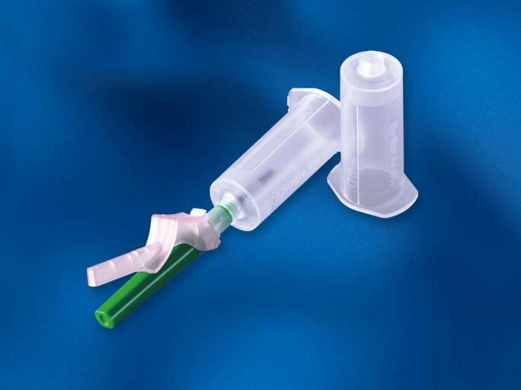
Blood Chemistry Procedures
Vacutainer tubes have a vacuum created to place a needle and syringe into a rubber plunger.
Each test requires a specific amount of blood, serum, or plasma to run the sample
Allow the samples that require centrifuging at least 30 minutes to clot prior to spinning but not more than 60 minutes

Slide 11
Blood Chemistry Procedures
Different tubes are used for specific requirements.
Red Top- Sterile or no anticoagulant that contains a gel separator
Tiger Stripe- Contains no silicone, gel separators, anticoagulants, or additives of any kind
Lavender Top- Sterile, contains EDTA as the anticoagulant
Green Top- Sterile, contains lithium heparin as the anticoagulant
Light Blue Top- Sterile, contains sodium citrate as the anticoagulant
Gray Top- Sterile, contains potassium oxalate and sodium fluoride as the anticoagulant

Slide 12
Blood Chemistry Procedures
Allow the samples that require centrifuging at least 30 minutes to clot prior to spinning but not more than 60 minutes

Slide 13
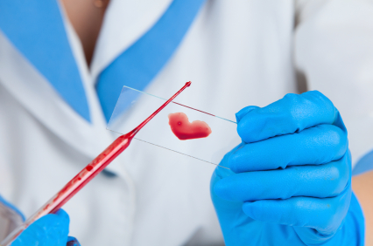
Blood Chemistry Procedures
Specific procedures
Complete Blood Count
evaluates the different types of white blood cells
Blood Smear
evaluates the blood cell morphology
Packed Cell Volume
measurement of the percentage of red blood cells in whole or unclotted blood (also a hematocrit).
Plasma Protein (total protein)
measures the ratio of protein within the blood and checks the hydration of the patient

Slide 14
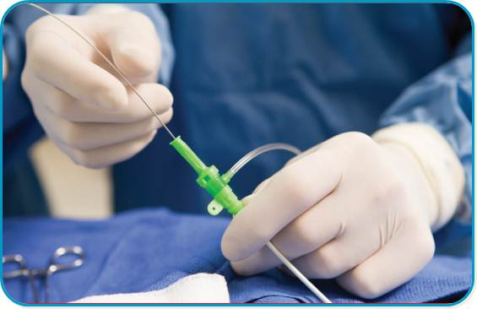
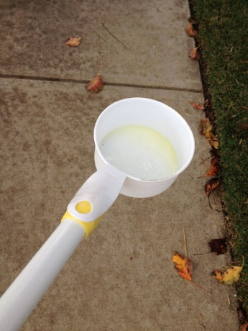
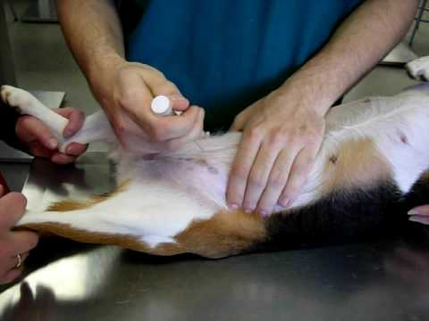
Urine Sample
Complete exam is called the urinalysis
Urine Collection
Voided samples- collected as the animal is urinating midstream
Catheterization- thin rubber or plastic tube inserted into the urinary opening
Cystocentesis- surgical puncture into the bladder using a needle to collect a urine sample.
Gross Examination
Physical appearance- noting clarity, color, consistency, odor and presence of foam

Slide 15
Urine Sample
Chemical properties
tested by using a reagent strip also called a chem strip or dip stick
drop of urine is placed on each square pad of the strip and the values are recorded on the urinalysis sheet
Microscopic Evaluation
places the urine in a centrifuge tube and spin down to evaluate the sediment that remains
the sediment is stained and placed on a clean slide with the patient name, client name, and date
Urine Specific Gravity
A drop of the urine sample is placed on the refractometer

Slide 16
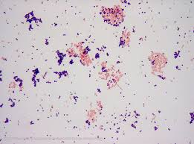
Other tests
Gram Stain
determines for the presence of bacteria and type of bacteria in a sample
Gram positive stain purple and gram negative stain red
Shape may be rods or cocci
After the slide is prepared it is dipped into stains:
crystal violet (purple)
Lugol’s iodine (orange)
saffranin (red)
decolorizer as a rinse

Slide 17
Other tests
Culture and Sensitivity
determine bacterial or fungal growth in a culturette tube that is left untouched for 4-6 weeks to be observed

Slide 18
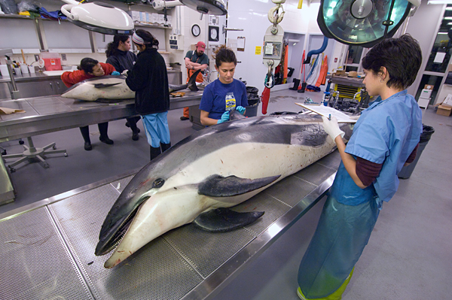
Other tests
Necropsy
examining the body of a deceased animal to determine the cause of death

Slide 19
STOP

Slide 20
Recording Laboratory Results
All results should be placed in the patient’s medical record
Some laboratory tests are also kept in logs in the lab area
The veterinarian is responsible for interpreting the results

Slide 21
Recording Laboratory Results
All results are given with reference values and vary from laboratory and notebook
Laboratory log books should be maintained and kept neat and clean in a three ring binder with clear plastic sleeves
Medical charts should have an area to place all laboratory reports with newest being on top

Slide 22
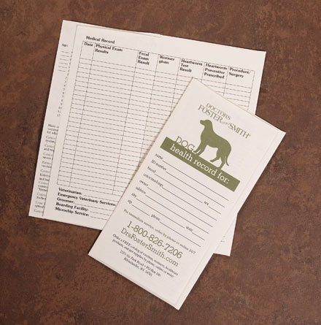
Importance of proper record keeping
Results should be clearly identified and transferred immediately to a patient’s chart
The veterinarian is ultimately responsible to make sure the results are read correctly
The recording of the records is done typically from the veterinary assistant

Slide 23
Typical Laboratory Procedures Recorded in the Patient’s Medical Record
Fecal Sample/Float- record gross observation (color, consistency, etc), types of eggs observed under magnification, any additional characteristics
Blood Chemistry-type of test, blood chemistry results, or any serologic Urine
Serologic or Urine Sample- record gross observation (color, clarity, consistency, etc), chemical reagent strip results, and specific gravity

Slide 24
Typical Laboratory Procedures Recorded in the Patient’s Medical Record
Gram Stain- microscopic evaluation after staining
Culture and Sensitivity- record color change and growth during the 4-6 week test period
Necropsy- sample results after received from diagnostic lab

