Slide 1
Veterinary Assisting Unit C
Animal Care and Management

Slide 2
Essential Standard 5.00
Evaluate safe handling and safety techniques for patient management.

Slide 3
Objective 5.01
Evaluate proper restraint techniques for each species.

Slide 4
Essential Questions
Why is proper restraint of animals a critical skill?
What equipment may be used to restrain an animal?
What positions are commonly used to restrain animals?
What knots are used in animal restraint?

Slide 5
Restraint Considerations
Restraint
Hold back, check, or suppress an action and keep something under control using safety and some means of physical, chemical, or psychological action

Slide 6
Restraint Considerations
Used by veterinary staff to allow an animal to be controlled for procedures
Safety of animal and of the people
Sedative/Tranquilizer
medication given to an animal to keep it calm during certain stressful procedures or circumstances

Slide 7
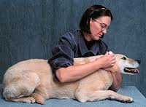
Animal Safety
Those not accustomed to humans will become easily stressed when removed from territory
Young animals
handle with care; small and brittle bones
Older animals
handle with care; may be arthritic and painful

Slide 8
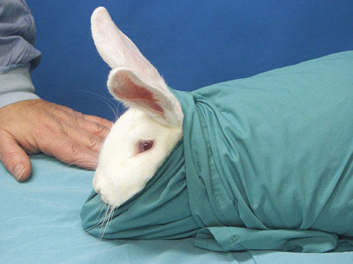
Animal Safety
Safety of animal and staff must be considered every time restraint is necessary
Never allow non-veterinary staff or animal owner to restrain any animal
Potential legal issue

Slide 9
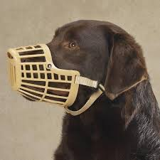
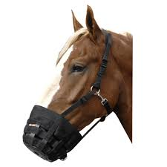
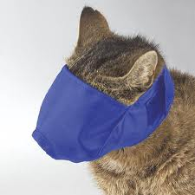
Restraint Equipment
Muzzles, anti-kick bars, hobbles, or stanchions
Muzzles
commonly for dogs, cats, and horses
made of nylon, leather, wire, or basket materials
can be made with gauze, tape, or leashes
Towels
used to restrain small animals
used to wrap and contain

Slide 10
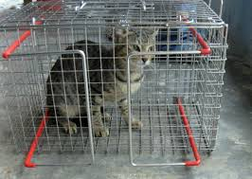
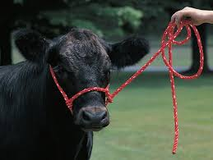
Restraint Equipment
Squeeze cages
used with small animals
contains animal without placing a person’s hands directly on animal
Halters and Leads
used on large animals
halter is placed on the head and lead rope attached
Twitch-restraint device attached to a horses upper lip
Nose tongs
used in cattle
applies pressure to the inside of nostrils

Slide 11
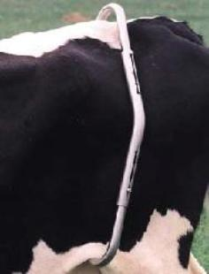
Anti-kick bars

Slide 12
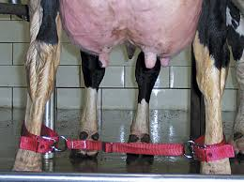
Hobbles

Slide 13
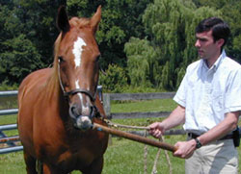
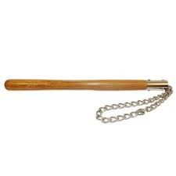
Chain Twitch

Slide 14
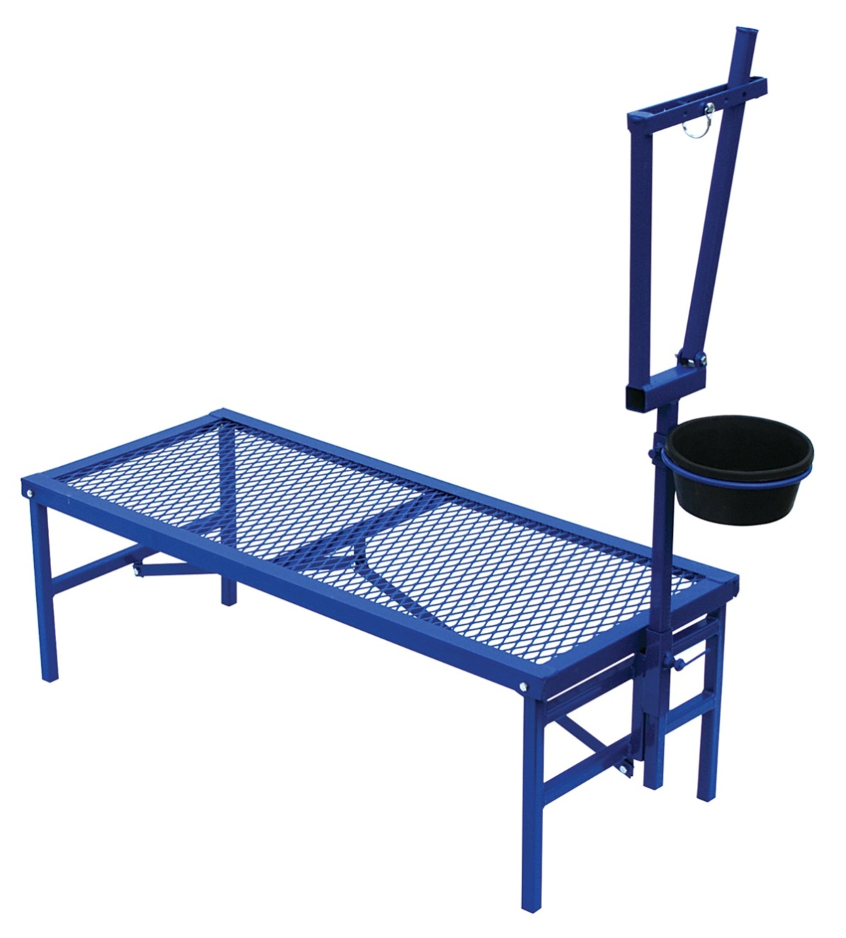
Stanchion

Slide 15
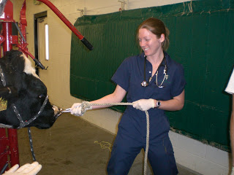
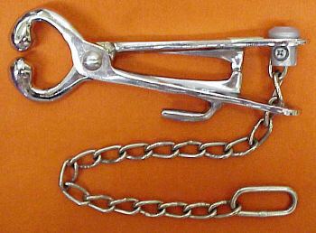
Nose tongs

Slide 16
Muzzles

Slide 17
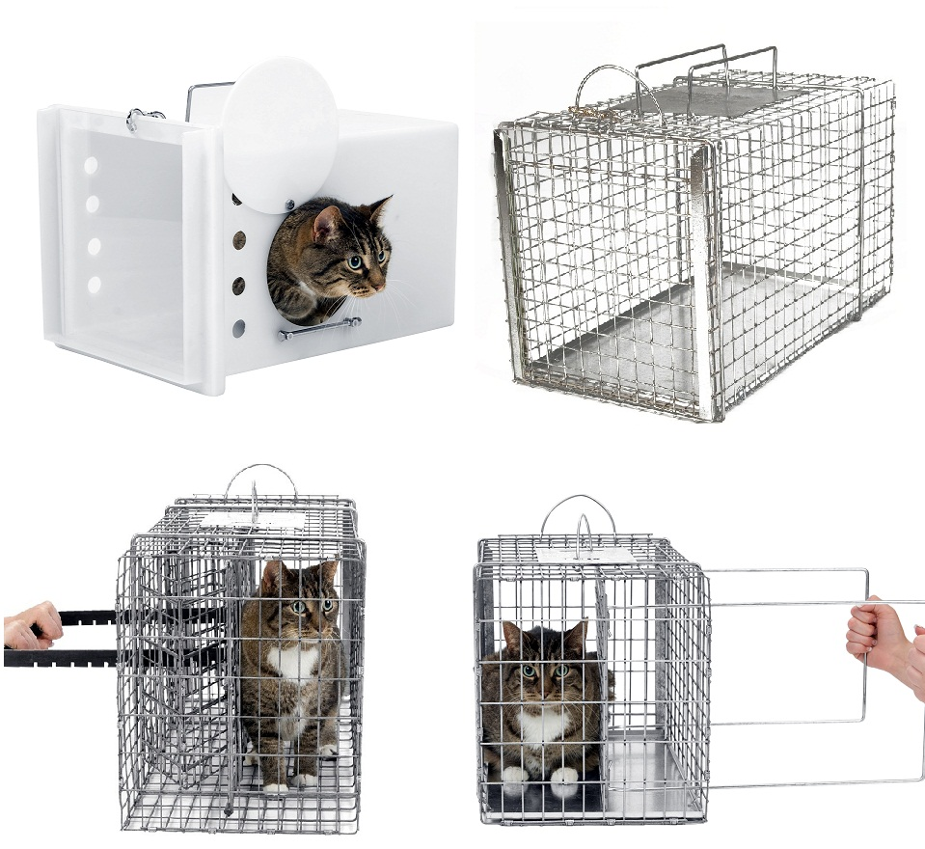
Squeeze cages

Slide 18
Planning the Restraint Procedure
Area with enough room, is clean, is dry, and is well lit
Plan should be discussed
Move any costly equipment
Nonslip area
Temperature should be considered
What should be done if animal happens to get away from restrainer
Backup plan

Slide 19
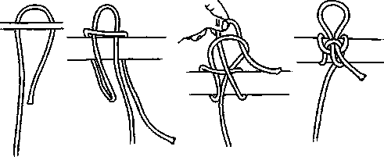
Restraint Knots
Knots are made from one to two pieces of rope material where one section of the rope prevents slipping of another
Allow animals to be tied and restrained for a temporary period of time
Ropes should be inspected
Ropes may be used to tie animals in position

Slide 20
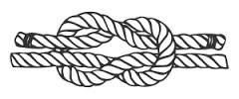
Restraint Knots
Square Knot
Commonly used to secure an animal
Nonslip knot that doesn’t come untied
Two ropes or a single rope can be used to make the square not

Slide 21
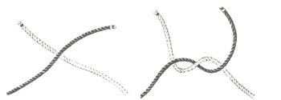
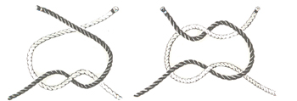
Square Knot

Slide 22
Restraint Knots
Reefer’s Knot
Single bow knot that allows a nonslip, quick release tie
Same as the square knot with the exception that the second throw is made upon itself, creating a hold that can easily be untied
Common tie for large animals to prevent them from injuring their heads and necks during restraint

Slide 23
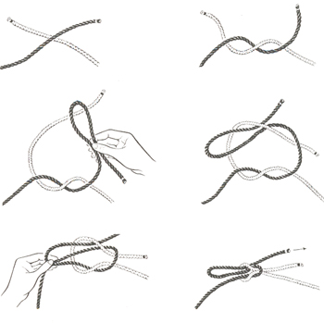
Reefer’s Knot

Slide 24
Restraint Knots
Half Hitch
Tie that makes a loop around a stationary location such as a post or a fence
Commonly used to secure an animal to a surgery table

Slide 25
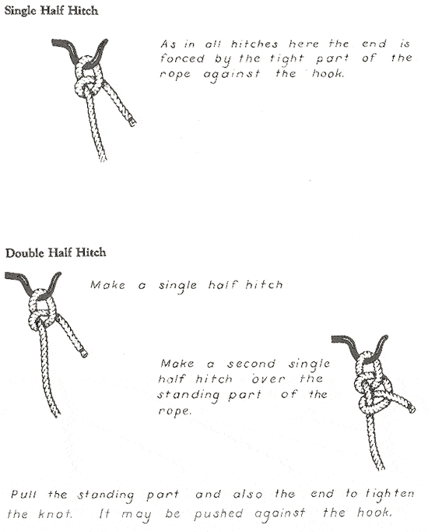
Hitches

Slide 26
Restraint Positions
Recumbency
lying position

Slide 27
Restraint Positions
Standing restraint
used to keep an animal standing for a procedure and to prevent it from sitting or lying down

Slide 28
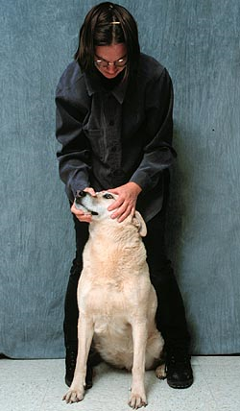
Restraint Positions
Sitting restraint
used to keep an animal in a sitting position for ease of completing a procedure

Slide 29
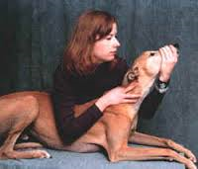
Restraint Positions
Sternal recumbency
placing the animal on its chest for restraint

Slide 30
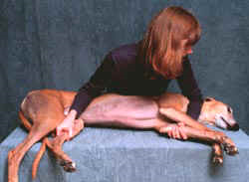
Restraint Positions
Lateral recumbency
placing the animal on its side for restraint
May be done in left or right lateral recumbency

Slide 31
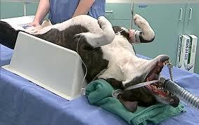
Restraint Positions
Dorsal recumbency
used to place the animal on its back for restraint; is a common restraint during surgical procedures and radiology techniques

Slide 32
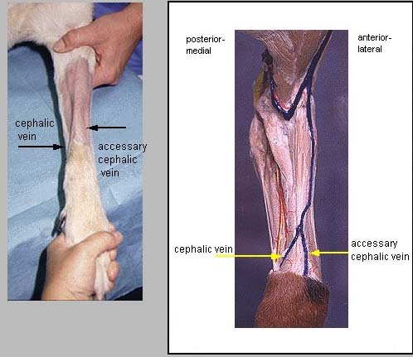
Blood collection
Cephalic vein
located in the medial aspect of the front limbs known as cephalic venipuncture

Slide 33
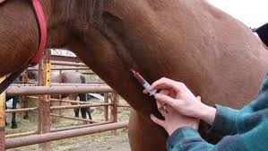
Blood collection
Jugular vein
located on either side of neck in lower throat area

Slide 34
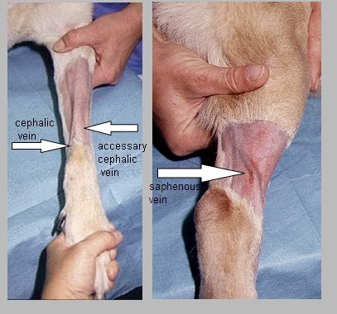
Blood collection
Saphenous vein
located on lateral surface of the rear limbs just proximal to the hock

Slide 35
Small Animal Restraint
Animal is held in safe manner through body control
Common injuries: bites and scratches
Cats, dogs, rodents, rabbits, ferrets, reptiles, and birds
Diversions: talking to animal, calm noises, lightly blowing in face, or lightly rubbing temple area

Slide 36
Cats
Tend to be one of the most difficult during restraint when they become upset and aggressive from stress
Safely restrain and have control over the head
Cat bags: control the limbs and head
Squeeze cages: wire boxes with small slots that allow injections to be given

Slide 37
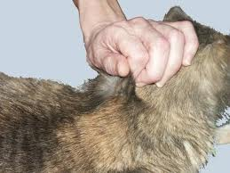
Cats
Anesthesia chamber: used to sedate
Scruff technique: gives control over head; may divert attention
Stretch technique: scruffing the cat with one hand while in lateral recumbency and using the free hand to hold the rear limbs and pull them dorsally

Slide 38
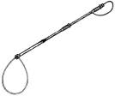
Dogs
Rabies pole or snare pole
is long, has noose on end, and acts as leash
captures and restrains dogs
pulling can cause severe head and neck injuries

Slide 39
Large Animal Restraint
Livestock: horses, cattle, goats, swine, and sheep
Instincts of prey animals
“Fight or flight” instinct as part of reaction to restraint
Capable of: kicking, biting, rearing up into the air, or using their large bodies to injure

Slide 40
Large Animal Restraint
Horses:
Several types of twitches available
Holding up one leg while working on another leg
Skin Pinch on neck
Chain lead shank

Slide 41
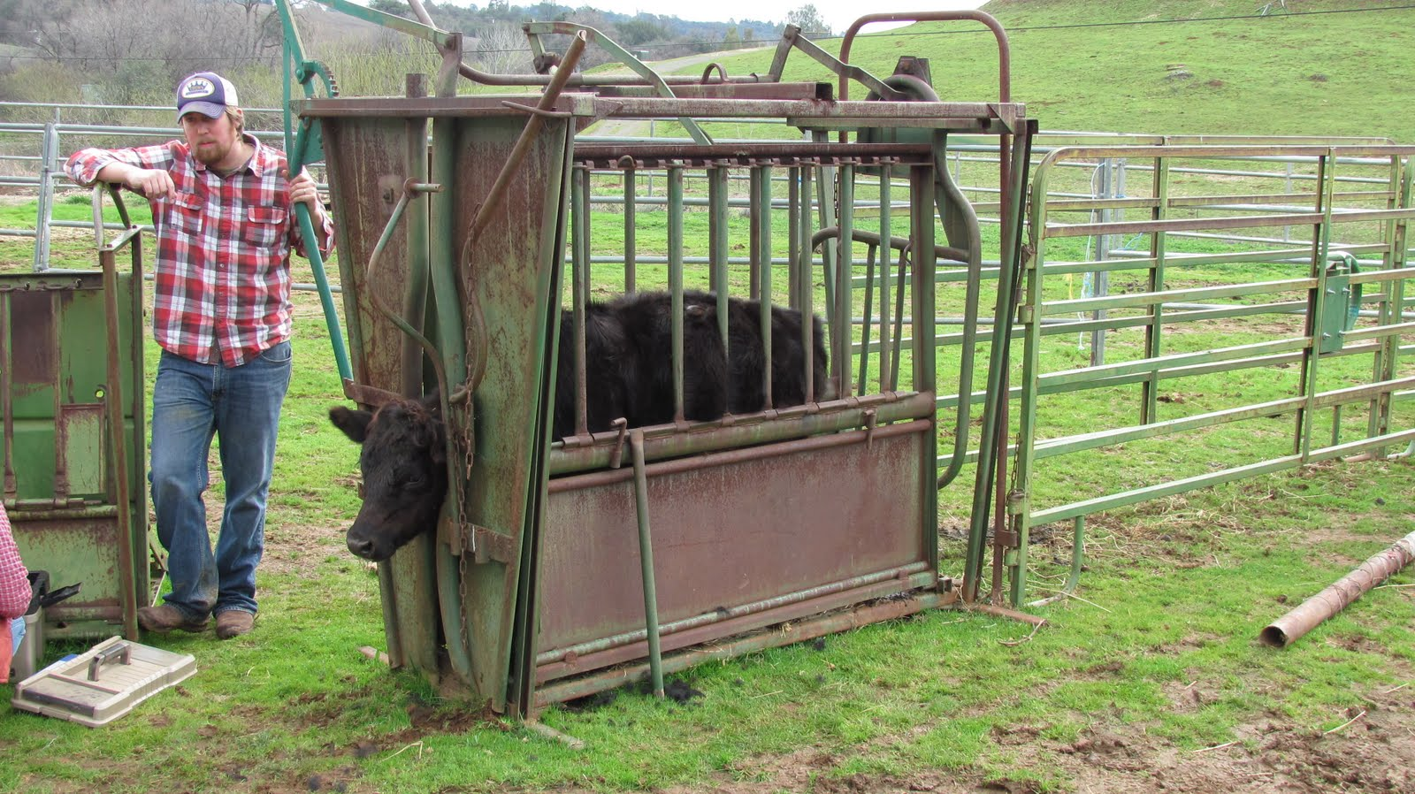
Large Animal Restraint
Cattle:
Nose tongs
Head gates
Squeeze chutes

