Slide 1
Objective 5.02
Evaluate proper safety protocol in a clinical setting.

Slide 2
Essential Questions
Why is it important to understand how an animal behaves?
What are the instinctive behaviors?
How do instinctive behaviors compare to learned behaviors?
How do you distinguish between normal and abnormal behaviors?
What are vital signs?
What is a normal temperature/pulse/respiration for each species?
What skills is a veterinary assistant responsible for?
What are basic grooming procedures the veterinary assistant is responsible for?

Slide 3
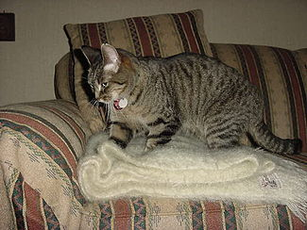
Animal Behavior
Instinctive behavior: Many in early life include:
Kneading of the paws on mother’s mammary glands
Mother and newborn
Marking
Predatory
Submission
Dominance

Slide 4
Instinctive Behavior
Acquired through an animal’s genetic makeup
Each species is built on somewhat different patterns
The brain and other parts of the nervous system generate a response to environmental input and hormones

Slide 5
Animal Behavior
Learned behavior: Modification of behavior in response to specific experiences
Conditioning – Process of teaching an animal an action in relationship to another action. Reward for coming to clicker sound.
Modeling – When animal learns behavior through watching other animals conduct the behavior
Imprinting – Due to a process that must occur within a distinct, usually short time period.

Slide 6
Distinguishing Normal from Abnormal Behaviors
Animal Species | Normal Behaviors | Abnormal Behaviors
Dog | Barking, marking, chewing, digging, jumping | Aggression, biting, growling, food aggression, destructive behaviors, house soiling, coprophagia
Cat | Chasing, pouncing, jumping, stalking, purring, hissing, hunting, grooming, scratching | House soiling, chewing,excessive self-grooming, destructive scratching
Rabbit | Grooming, coprophagia (eating feces), marking, growling, thumping | Biting, striking, hiding, screaming
Bird | Screaming, mimicking, preening feathers, biting, beak grinding | Excessive screaming, aggression, territorial, feather picking, self destruction, destructive chewing

Slide 7
Animal Species | Normal Behaviors | Abnormal Behaviors
Horse | Kicking, biting, flattening ears, whinnying | Bucking, rearing, charging, destructive biting, aggression, destructive chewing
Cow | Pushing, tail swishing, charging, pawing ground | Aggression, kicking biting
Goat | Butting, jumping, climbing, chewing | Aggression, destructive chewing, biting
Sheep | Butting, bumping, herd instinct, vocal, playful | Aggression, biting
Pig | Biting, squealing, bumping | Aggression, charging

Slide 8
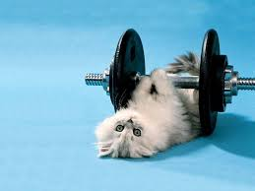
Socialization and Exercise of Patients
Provide the human interaction animals need when hospitalized
Petting
Talking
Holding
Exercise
Animals may not urinate in the cage

Slide 9
Examination Procedures to Evaluate the Safety of Animals
Vital Signs
Measurements to assess the basic functions of the body and include
heart rate
respiratory rate
Temperature
blood pressure
mucous membrane color
capillary refill time
weight

Slide 10
Examination Procedures to Evaluate the Safety of Animals
Temperature
shows sign of infection or other problems
Hypothermia
below normal body temperature
Hyperthermia
above normal temperature and causes body to have fever (can be sign of infection, stroke, or toxicity)
Heat stroke
considered when body temperatures exceed 105 degrees

Slide 11
Examination Procedures to Evaluate the Safety of Animals
Pulse
number of times the heart beats per minute
Taken by locating an artery
Heart rate is the number of times the heart relaxes and contracts in a minute taken with a stethoscope
Respiratory rate
how many breaths in a minute

Slide 12
Species | Normal Core Body Temperature (F) | Normal Heart Rates | Normal Respiratory Rates
Dog | 101-102 | 70-180 | 16-20
Cat | 101-102.5 | 170-240 | 20-30
Rabbit | 102-104 | 130-325 | 32-60
Guinea Pig | 100-103 | 240-350 | 40-150
Horse | 99-100.5 | 35-45 | 8-16
Cow | 101-101.5 | 60-70 | 10-30
Sheep | 102-102.5 | 60-80 | 12-20
Goat | 103-103.5 | 70-80 | 12-20
Pig | 102-102.5 | 60-80 | 8-15
Chicken | 105-106 | 200-400 | 15-30
Hamster | 101-102 | 250-500 | 35-135

Slide 13
Examination Procedures to Evaluate the Safety of Animals
Blood pressure
tension exerted by blood on the arterial walls and is measured by a sphygmomanometer (blood pressure cuff)
Systolic
ventricles contract
Diastolic
ventricles relax

Slide 14
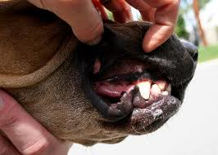
Examination Procedures to Evaluate the Safety of Animals
Mucous membranes
color of animal’s gums
Capillary Refill time
place a finger on gums with a small amount of pressure allowing area to turn white
normal 1-2 minutes

Slide 15
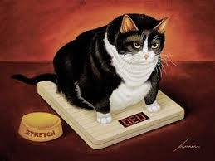
Examination Procedures to Evaluate the Safety of Animals
Weight assessment
animals are evaluated to check for obesity or thin body conditions
use a size appropriate scale or weight tape

Slide 16
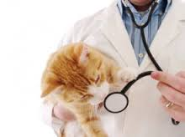
Examination Procedures to Evaluate the Safety of Animals
Auscultation
Stethoscope is used to listen to the chest area
Heart area can be located by taking the front leg and pulling it back to the chest or thorax area and where the elbow hits the chest
Bradycardia
slow heart rate
Tachycardia
fast heart rate

Slide 17
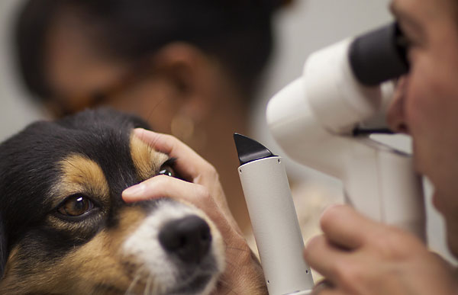
Examination Procedures to Evaluate the Safety of Animals
Eye Exam
Normal eyes are clear and responsive
Jaundice
yellowing of the skin
PLR- pupillary light response
normal
direct PLR
abnormal
indirect PLR

Slide 18
Examination Procedures to Evaluate the Safety of Animals
Ears
note any smell, swelling, redness, or discharge
Dental Exam
check for tooth problems
Plaque- soft building of material on surfaces of teeth
Calculus (tartar)- mineralized plaque
Gingivitis- inflammation of gums
Tooth abscess- roots of teeth can have a problem when a tooth is broken

Slide 19
Veterinary Assisting Procedures and Proper Handling to Ensure the Safety of Animals

Slide 20
Dental Care
Veterinary assistant is responsible for:
Preventive care
Teeth brushing

Slide 21
Dental Care
Daily dental care and brushing
Feed a hard, dry diet
Provide hard treats, dental toys, or bones
Proper brushing
Never use human toothpaste
Use toothbrush for the species
Only the buccal, labial, and occlusal surfaces are brushed

Slide 22
Dental Care
Buccal – Outer area near cheek
Occlusal – Top area of teeth
Labial – Front area covered by the lips

Slide 23
Dental Care
Large animals
Require floating
Filing the sharp areas of the teeth
Requires special training
Horses generally need this type of dental care

Slide 24
Dental Care
Dental Prophylaxis
Responsibility of the veterinary technician
Veterinary assistants may be asked to assist but should not perform the procedures on their own
The animal is placed under anesthesia
The teeth are examined and then scaled and polished

Slide 25
Fluid Administration
Used to replace fluids related to illness or dehydration
IV placement is done by the veterinary technician
The veterinary assistant should be able to monitor the IV catheter and the fluid line

Slide 26
Fluid Administration
Subcutaneous Fluid Therapy
Treatment for:
Kidney disease
Urine collection
Minimal vomiting and diarrhea
Lactated Ringer’s Solution most commonly used
Absorption rate is generally 6 to 8 hours

Slide 27
IV Catheter Monitoring
Catheter is placed in the vein to administer fluids and medication into the blood stream
Procedure done by veterinary technician or veterinarian

Slide 28
IV Catheter Monitoring
The assistant is responsible for:
Monitoring patency – proper flow, device is intact, and useable
Monitor rate of flow
Checking and changing the bandages
Observation of damage to site or signs of infection or swelling

Slide 29
IV Fluid Monitoring
The veterinary assistant should monitor:
Flow rate
Notations of volume administered
Macrodrip delivers 15 drops of fluid per milliliter
Microdrip delivers 60 drops of fluid per milliliter

Slide 30
Euthansia
Process of putting an animal to sleep using humane methods by means of a painless death
Should be as pain and stress-free as possible
Staff should be supportive and remember client confidentiality
Exam room should be prepared with box of tissues, blanket/towel, chairs for family members, and other needs

Slide 31
Euthansia
Place cadaver gads out of sight of family
Prepare to sedate if necessary
Watch for agonal respirations – gasps of breath while respiratory system shuts down
Remove collars and ensure proper identification of the animal for burial, cremation, hospital care, or client return

Slide 32
Expressing Anal Glands
Located on either side of the rectum – lie ventrally and slightly anterior to the skin at 4 and 8 o’clock positions
Wear gloves and gently palpate the ventral and lateral sides of the anus, the tail is held upward and out of the way
Place a paper towel over the area and gently press the fingers while squeezing each sac
Note the secretion, color, and consistency

