Slide 1
Record Keeping
Essential Standard: Apply proper usage of veterinary practice management procedures
Objective: Analyze methods to correctly maintain veterinary medical records

Slide 2
What is the Purpose of a Medical Record?
Provides a diary of an animal’s health for the veterinarian
Allows each veterinarian to easily modify and transfer records to one another

Slide 3
Medical Records Include:
Patient
Client
Patient History
Medical/Surgical Records
Progress Notes
Lab Information

Slide 4
Ethics of Medical Records
The medical record is owned and is the property of the Veterinary Facility
Serves as a legal document that is private and confidential
Allows for the Veterinarian- Client- Patient- Relationship (VCPR) to be established which provides the opportunity for the veterinarian to make judgments regarding health, diagnosis, how to provide care, and the way records are maintained

Slide 5
Ethics of Medical Records
The medical record is owned and is the property of the Veterinary Facility
Must remain in the facility for 1-3 years although many hospitals keep records for 7 years after last visit.

Slide 6
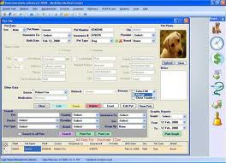
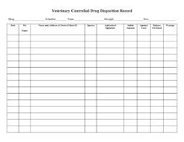

Slide 7
How to Create a Medical Record
Files should include the following sections or forms:
Client and Patient Information
Master problem list with details of a patient’s history and previous medical problems, vaccines, or surgeries

Slide 8
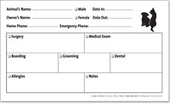
When write the medical record…
Also make a cage card to identify and locate each patient.

Slide 9
After treatment is recommended…
By the veterinarian an estimate sheet will be prepared with costs listed
Treatment will be reviewed with the client and consent forms signed
Care will also be reviewed with the client so the owner can continue to medicate and care for the patient
The invoice should be placed on top for easy access for all in the veterinary clinic

Slide 10
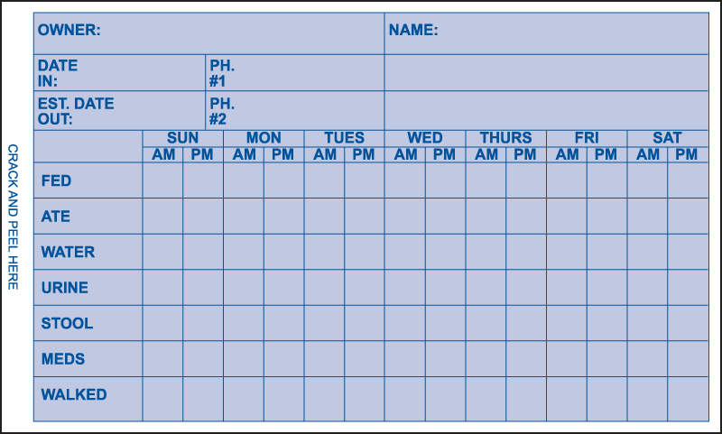

Slide 11
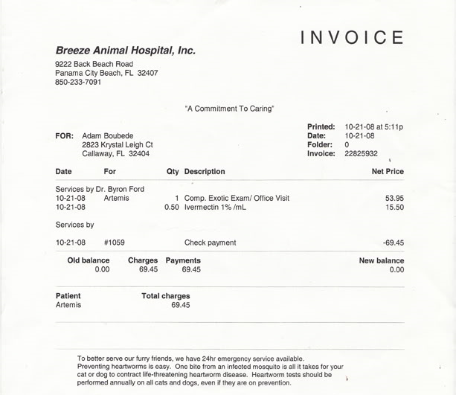

Slide 12
How to Record Information
All information must be recorded in BLUE or BLACK ink (NEVER in pencil or other ink colors)
All information should be accurate and legible – if a mistake is made then place a single line through the error and initial the error then place the corrected statement after the entry

Slide 13
How to Record Information
Record all communications with clients in the record and initial
One record per patient

Slide 14
SOAP
SOAP: Subjective, Objective, Assessment, and Plan.
Subjective: Animal’s overall appearance (Demeanor)
Objective: Vials- TPR (Temperature, Pulse, Respiration), Weight, and Basic Goals of exam
Assessment: Veterinary Diagnosis
Plan: Treatment or Procedure

Slide 15
Filing Medical Records
Paper or Computer records are available
Most facilities use a combination of both
Records written first then entered into the computer
Paper Records:
Stored in a file folder or manila envelope with pockets or clasps
Computer Records:
Variety of programs exist

Slide 16
Storage of Medical Records
Common Filing Systems:
Alphabetical:
By client’s last name with color code and first 2-3 letter of the last name
Numerical:
Client assigned number or each patient assigned a number
Each digit is assigned a color and year is clearly identified

Slide 17
Consent Forms
Consent forms are used to identify to the client any recommended procedures with prices while patients is under the veterinary facility care
Client signs consent form to show agreement of medical care and risks
Serves as a legal agreement

Slide 18
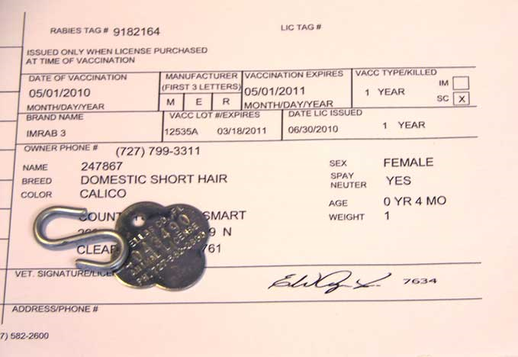
Certificates
Neuter Certificate:
Provides proof that the pet has been spayed or castrated. No longer sexually intact
Rabies Certificate:
Rabies vaccine is legally required. Provides proof animal has had the vaccine if it bites another pet or person.

Slide 19
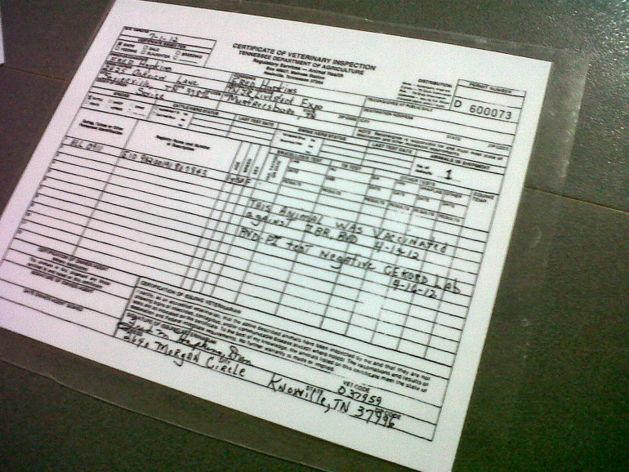
Certificates
Health Certificate:
Issued if animals are being transported out of state or country
Includes:
Physical Exam from veterinarian
States animal is free of disease
Required Vaccines are up to date

Slide 20
Medical Records as Legal Documents
Staff should protect the personal privacy of clients by maintaining confidentiality
All information in a record is private and not discussed without approval
Client should sign a waiver of for release of records

Slide 21
Invoicing
Veterinary Assistant should be able to invoice procedures
Can be completed on paper or with a computer program
Recording the procedure and cost of the procedure
Totaling the amount (include taxes) and process the accepted methods of payment.

Slide 22
Invoicing
Patient: “Buddy” Jones 8/2/2012
Procedures:
Exam $50.00
Office Fee $10.00
Vaccines $75.00
Total: $135.00
Tax: + $9.11
Grand Total: $144.11 Method of Payment: Check (# 112)

