Slide 1
Surgical and Radiological Procedures
Veterinary Assisting

Slide 2
Essential Questions
􏰒 What are radiation safety practices within the veterinary facility?
􏰒 How are radiology logs maintained within the facility?
􏰒 How is a technique chart used in veterinary radiology?
􏰒 How are the proper settings applied to radiology equipment?
􏰒 How are calipers used in radiology?
􏰒 How are radiology logs maintained within the facility?
􏰒 How are identification markers used in radiology?
􏰒 What techniques are used for manual and automatic film developing?
􏰒 How are radiographs filed?

Slide 3
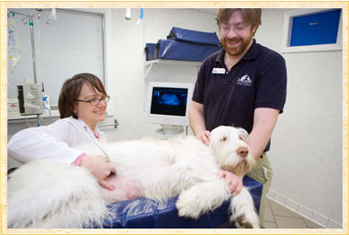
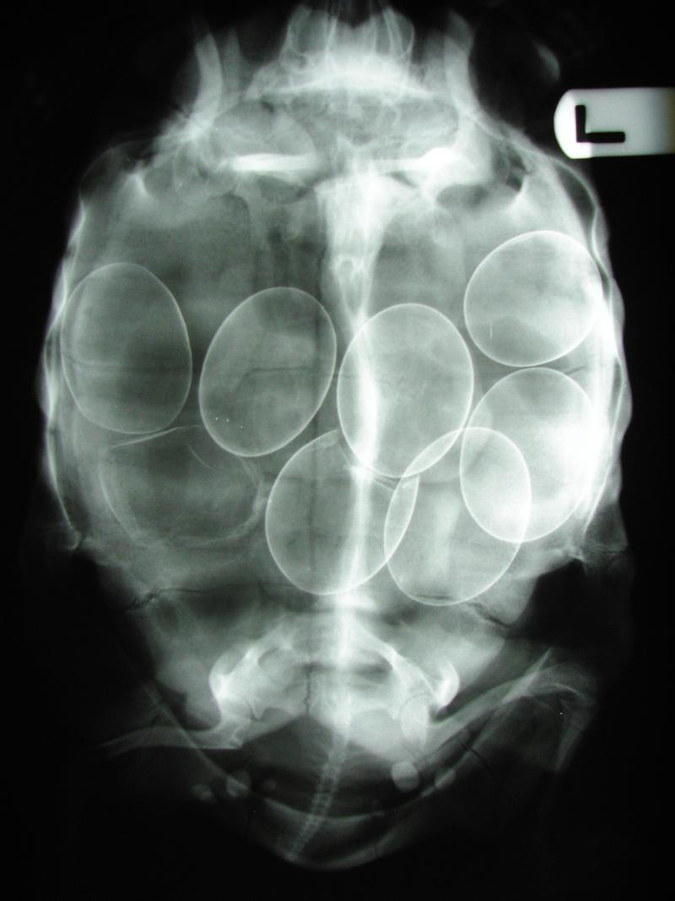
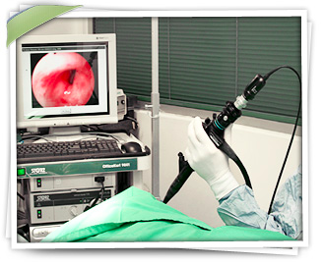
Diagnostic Imaging

Slide 4
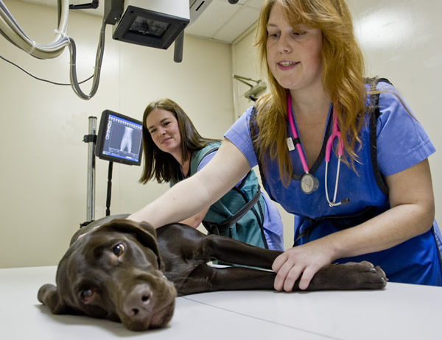
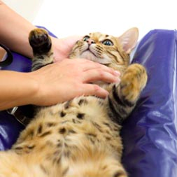
What is radiology?
Study of radiation and proper way to obtain radiographs.

Slide 5
Ultrasound Diagnostics
Use of ultrasonic waves to view images of internal organs.
Sound waves bounce off patient and create an echo within the tissues which are projected to the screen.
Transducer is a wand-like tool that scans the area.

Slide 6
Endoscopy
Visual examination of the interior of the body using an endoscope.
Endoscope is a series of fine glass rods that project an image through a light source.

Slide 7
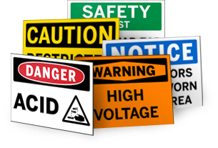
Radiation Safety
Standards are governed by OSHA and Department of Health.
Radiation causes
Damage to cells
Some cells more sensitive than others
Occurs with small exposures over a length of time
Radiation is invisible

Slide 8
Dosimeter (Badge)
Measures radiation exposure.
Should be worn by anyone with increased risk of occupational exposure.
Pregnant women have a special badge and are not allowed to be exposed to radiation.
CLEAR!!!!!!!!

Slide 9
Protective Equipment
Lead aprons, gloves, and shields.
Do not fold lead materials.

Slide 10
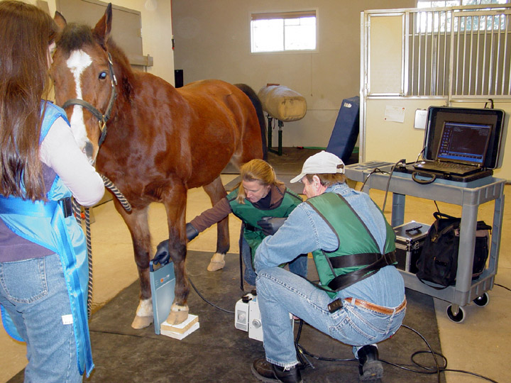
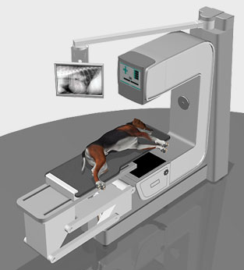
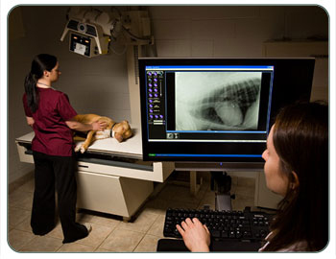
Radiograph Equipment
Cassettes
Screen
X-ray log
X-ray machine
Collimator

Slide 11
Radiology Terminology
Radiopaque (White)
Radiolucent (Black)
Milliamperage (mA)
Kilovoltage peak (kVp)
LAT
VD
DV
Oblique
AP
X-Ray Packages (3)
Thoracic
Abdomen
Pelvic
Skull
Spine
Long Bone
Contrast mediums
Barium sulfate
Lower GI
Upper GI

Slide 12
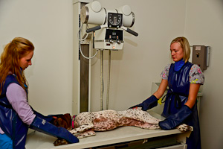
Veterinary Animal Restraint
Positioning patient and keeping patient still.
Most common right lateral recumbency.

Slide 13
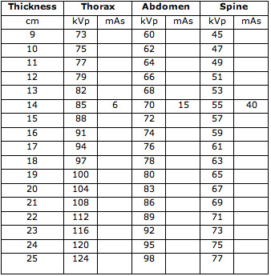
Technique Chart
List of settings on the machine based upon thickness of area to be exposed.
Grid technique
Film not in contact with patient
Radiation source is lower
Tabletop technique- Cassette is in contact with patient

Slide 14
Machine Setting Procedures
On/off switch
kVp knob
mA knob
Timer

Slide 15
Radiology Log
Legally required document.
Meeting standards of profession.
Comparison on techniques for patient follow-up films.
Recording quality of film taken.
State practice acts outline required information for the log.

Slide 16
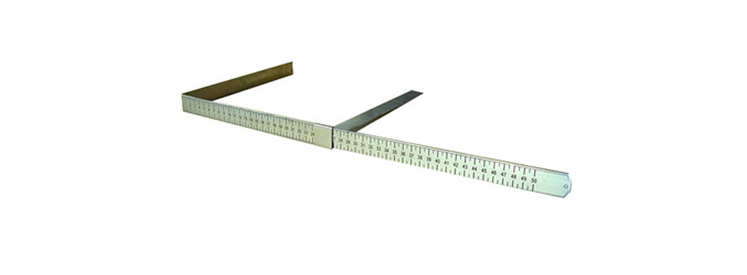
Patient Measurement
Calipers- Device used to measure thickness of a body part.
Centimeters-Scale used for x-rays.

Slide 17
Film Identification
Hospital name, address, and phone number
Veterinarian’s name
X-ray number
Client’s name
Patient’s name
Date
Directional label

Slide 18
Developing Film
Manual
Done by hand
Takes longer
Is less expensive
Automatic
Done by machine
More expensive
Quicker
Better quality
-Film is fed through machine and undergoes same process as manual.
Manual Developing
Developing tanks
Developer solution
Left side
Develops the film
Fixer solution
Right side
Fixes film and maintains life of film
Wash tank
Far right
Rids film of chemicals

Slide 19
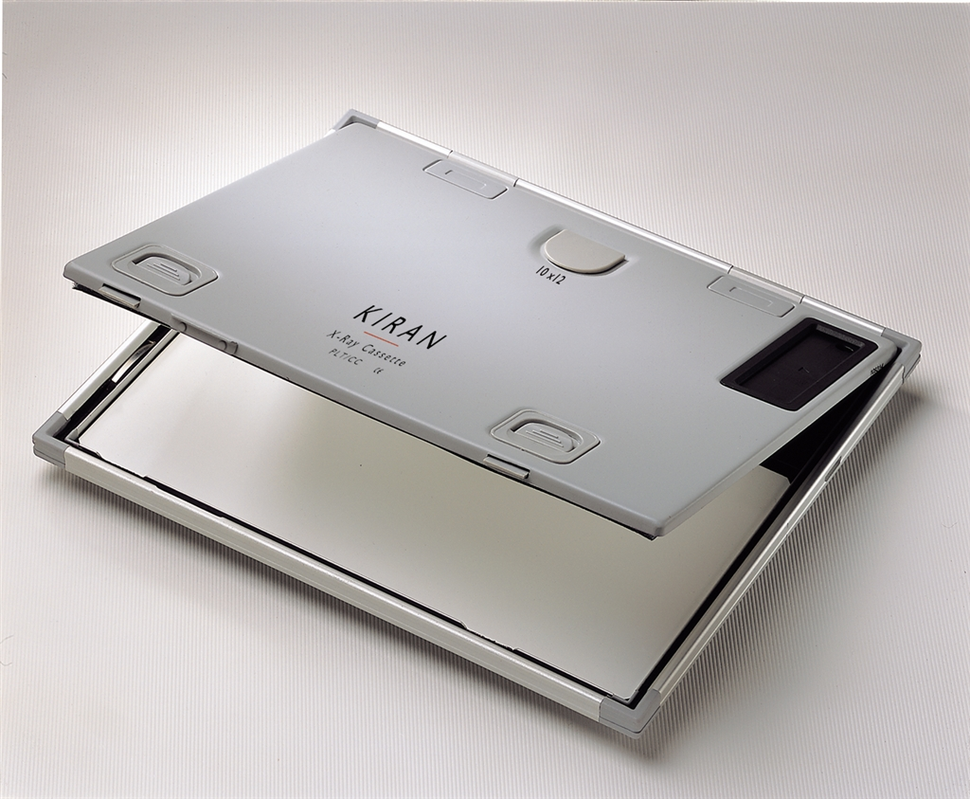
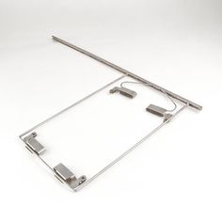
Manual vs. Digital (Automatic transfer to computer)
Cassettes
Hanger
Hold the film
Prevent exposure of film to light
Handle with care to avoid artifacts on the film
Used to secure film for processing
Metal frame
Allows film to hang in tanks

Slide 20
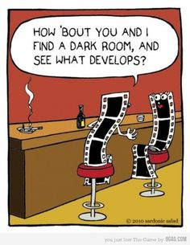
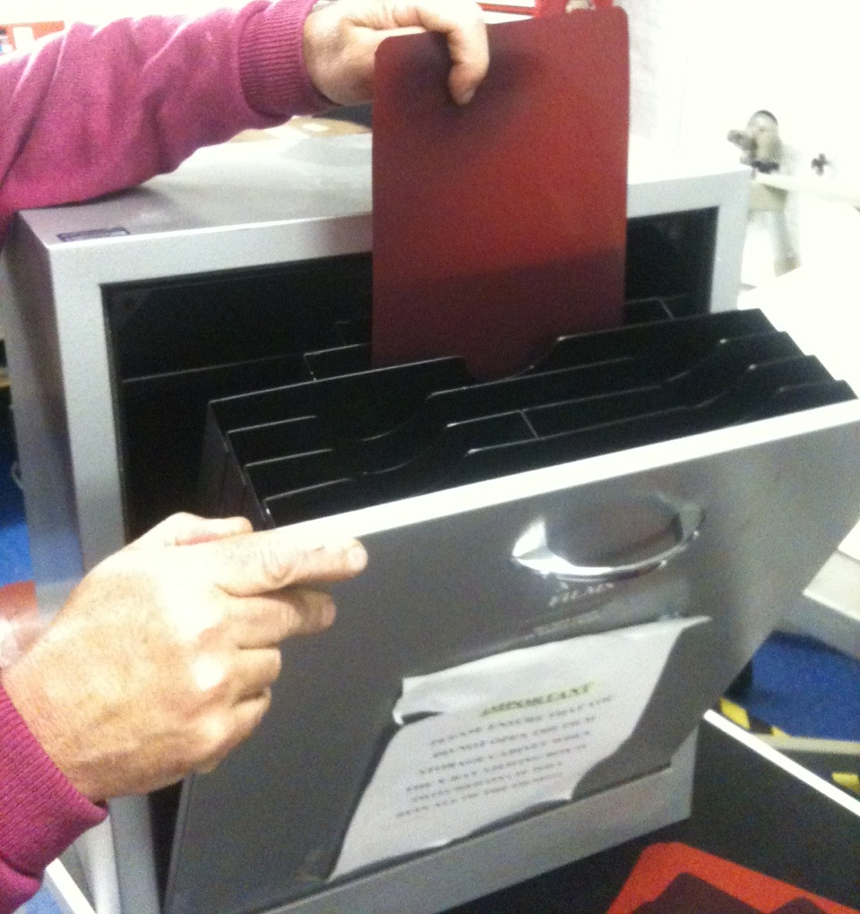
Film Care, Maintenance, & Storage
Filing film
Stored and filed in much the same manner as medical records.
Maybe done alphabetically or numerically.
Darkroom care and maintenance
Should be clutter-free and clean
Should be free of light leaks
Unexposed film should be placed on counter with a metal object on the film
Has a wet side and a dry side

